Slide 1
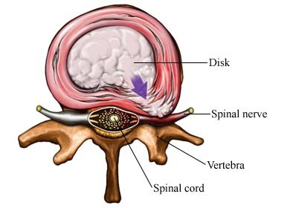
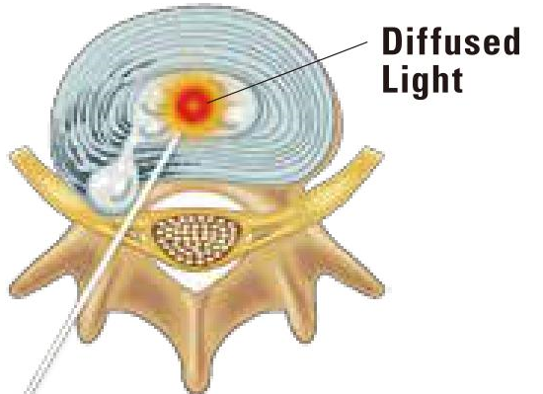
Percutaneous Laser Disc Discectomy(PLDD) is a Minimally Invasive Procedure for Prolapsed Intervertebral Disc(PID)
PLDD - PID

Slide 2
Prolapsed Intervertebral Disc (PID)

Slide 3
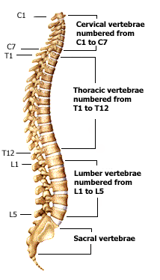
Anatomy of spine

Slide 4
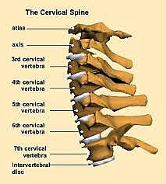
Anatomy of cervical spine

Slide 5
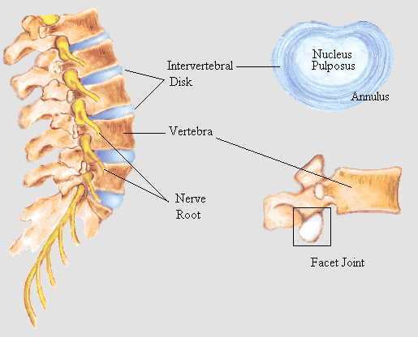
Anatomy of lumbar spine

Slide 6
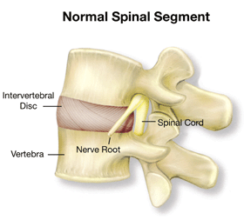

Slide 7
Prolapsed Intervertebral Disc (PID)

Slide 8
Prolapsed Intervertebral Disc (PID)

Slide 9
Contained herniation
Normal disc
Extrusion(prolapse)
Sequestration

Slide 10
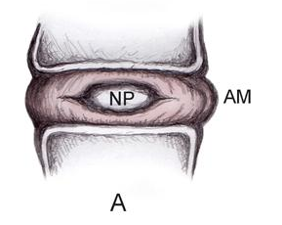
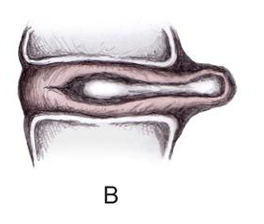
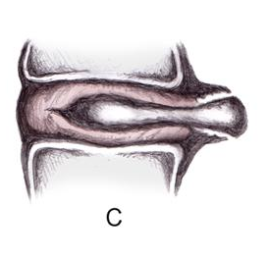
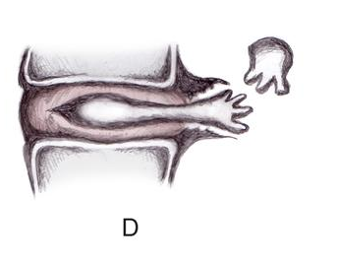
Normal disc
Contained herniated disc
Contained herniation protruded disc
Sequestrated disc

Slide 12
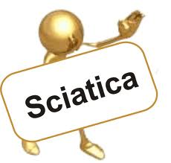
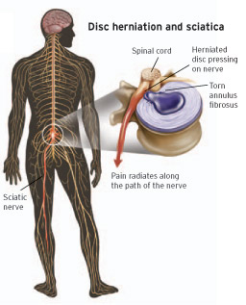
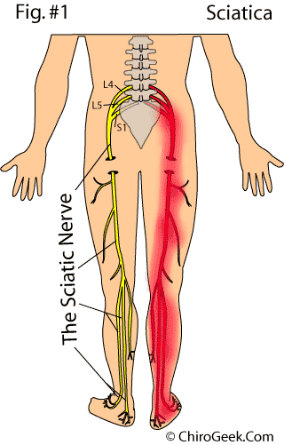
What is sciatica?
（sciatic nerve）

Slide 13
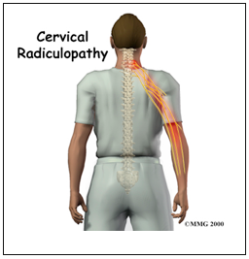
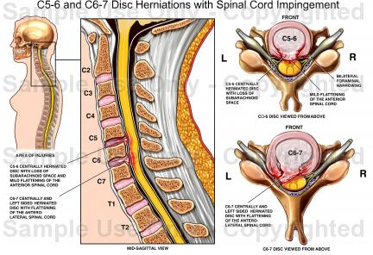
Radicular pain

Slide 14
Diagnosis

Slide 15
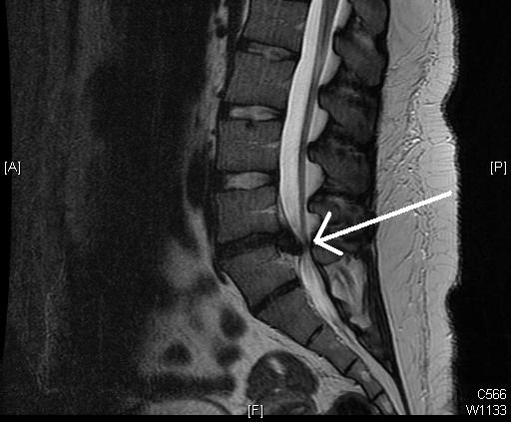
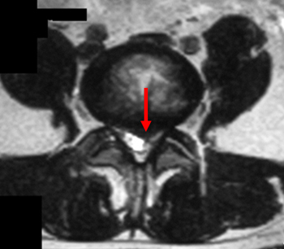
Magnetic Resonance Imaging（MRI ）
Prolapsed Intervertebral Disc（PID）

Slide 16
Treatment

Slide 17
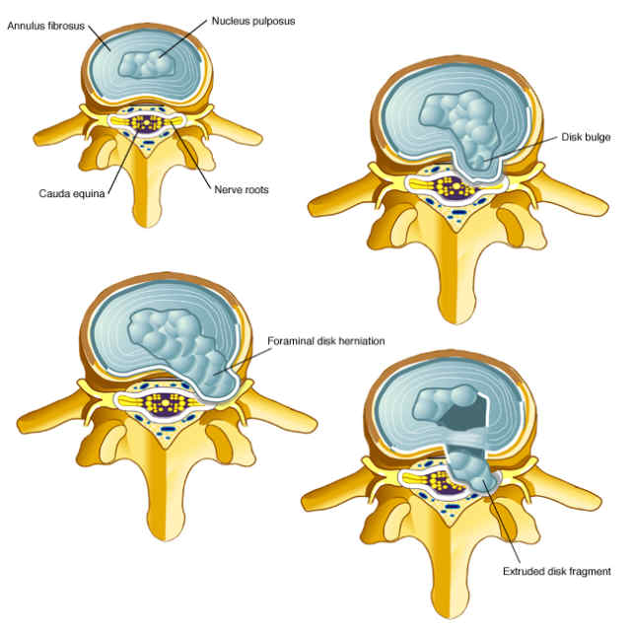
How to Treat a PID?
Conservative treatment
Operation treatment:
Percutaneous
PLDD
Herniated disc without nucleus pulposus
Endoscopy
Disc prolapse free type
Open
Open discectomy
Microdiscectomy

Slide 18
Percutaneous Laser Disc Discectomy (PLDD)

Slide 19
Percutaneous Laser Disc Discectomy（PLDD）
Broad Herniation
Protrusion
Percutaneous Laser Disc Discectomy surgery is the least invasive treatment compared to surgery (for non-prolapsed outer layer of the nucleus.
pulposus)The pulsed laser vaporizes the nucleus pulposus of the protruding intervertebral disc, reducing or eliminating the compression and stimulation of the nerves.
The success rate can reach 70-75%
Migration

Slide 20
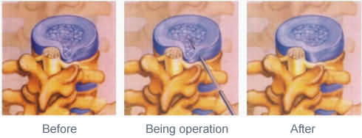
Percutaneous Laser Disc Discectomy（PLDD）
A spinal needle is used to enter the diseased intervertebral disc (nucleus) through the skin, a thin optical fiber is introduced through the needle, and then a laser is activated to vaporize part of the nucleus pulposus of the intervertebral disc.
The energy of the laser cavitates the lesioned nucleus pulposus, reduces the pressure in the intervertebral disc, relieves and eliminates the compression on the sciatic nerve or vertebral artery nerve, and does not cause damage to the peripheral nerve tissue.
After laser irradiation, the pressure in the intervertebral disc is reduced, and the nucleus pulposus is gradually replaced by cartilage fibers.
Based on experimental studies it has been determined that the temperature of the laser vaporized intervertebral disc does not have a thermal effect on the intervertebral foramen (neural foramen) or spinal canal.

Slide 21
PLDD
It was recognized by the US Food and Drug Administration (FDA) in 1991.
In January 2000, the American Medical Association awarded Current Procedural Terminology (CPT) codes.
Reimbursed by a U.S. third-party payer.

Slide 22
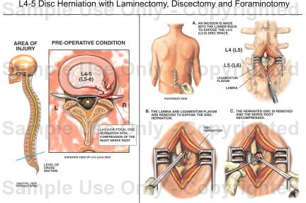
Open Discectomy
1934:
Traditional open disc decompression surgery.
This procedure was performed at Massachusetts General Hospital.
An incision has to be made, the surrounding tissue is pulled apart, which destroys the muscle fibers, then part of the lamina is cut, a hole is made in the annulus fibrosus and the nucleus pulposus is removed.
Eventually scar tissue will remain.

Slide 23
Open Discectomy
Conclusion:
Seriously affect the normal spinal structure. Due to the development of spinal instability, further spinal fixation and fusion surgery may be required.
Fixed fusion surgery:
Adjacent disc syndrome is due to the transfer of the original intervertebral activity of the fixed vertebral segment to the adjacent segment (upper or lower segment), resulting in excessive pressure on the adjacent segment, resulting in early degeneration and symptoms. Surgical treatment is also the use of a bone screw rod system to lengthen the fixed vertebral segment.

Slide 24
Percutaneous Disc Decompression
Chymopapain Injections
In 1964, Smith reported that chymotrypsin could promote the dissolution of human nucleus pulposus.
Percutaneous Nucleotomy
In 1975 Hijikata first described good or excellent results in 68% of patients.
Percutaneous Lumbar Discectomy
In 1985 Onik et al. introduced percutaneous lumbar discectomy.
Laser Discectomy
In 1987, Choy and Ascher were the first to use laser to vaporize the nucleus pulposus of the intervertebral disc.
Nucleoplasty
In 2000 Arthrocare introduced radiofrequency ablation (RF ablation) of the nucleus pulposus of the intervertebral disc.
Percutaneous Lumbar Discectomy
In 2002 Pain Concepts introduced the 1.5mm probe for percutaneous lumbar discectomy.

Slide 25
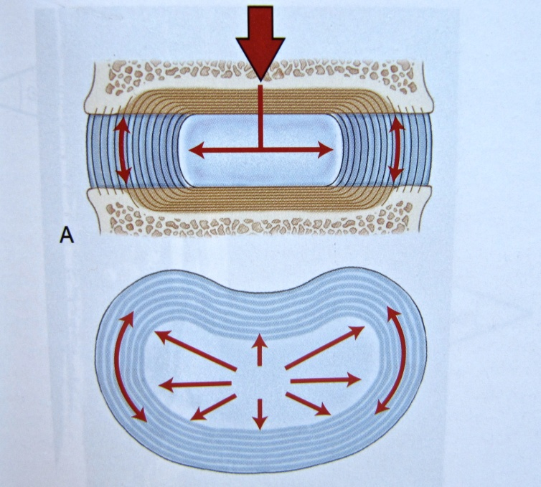
Definition of PLDD
1984
Problems exist in the open and fixed fusion surgery.
Dr Daniel S.J. Choy
holonomic intervertebral disk
closed hydraulic space
water cannot be compressed
small amounts of change will result in disproportionately large changes in the pressure of the disc
lead laser energy into the herniated disc
a small amount of the spinal cord was evaporatd
reduce the pressure in the intervertebral disc
the pressure is reduced
the order difference of the pressure is formed
Thus, the herniated disc is removed from the nerve root

Slide 26
Vitro Experiments with Live Creature
The first percutaneous laser disc decompression (PLDD) took two years of vitro experiments, when the carcass and cow spine were used.

Slide 27
Vitro Experiments:
The hydraulic space of the disc is closed,
A change of 1ml within the nucleus will directly cause a rise or decrease in 314 Kpa pressure.
Nd:YAG laser energy introduction of 1000 J
Vaporize approximately 200ml of the spinal fluid
Will result in a 50% drop in the pressure within the disc
The temperature of the adjacent tissue structures did not increase significantly.
After using a 1,000 J laser energy,
An olive laser beam will form, with the beam being 10mm long and 5-6mm in diameter.
Proteins are denatured, leading in water deficiency.
This can avoid moisture being reabsorbed after surgery and causing disc swelling.
Hellinger in intervertebral disc experiments in cattle demonstrated that collagen fibers were shortened after laser treatment, resulting in a contractile effect.

Slide 28
Vitro Experiments
Nuclear pulpulla 60-80% moisture
Reducing the small volume will cause a disproportionate decrease in the internal pressure
1 ml vary = 312 Kpa

Slide 29
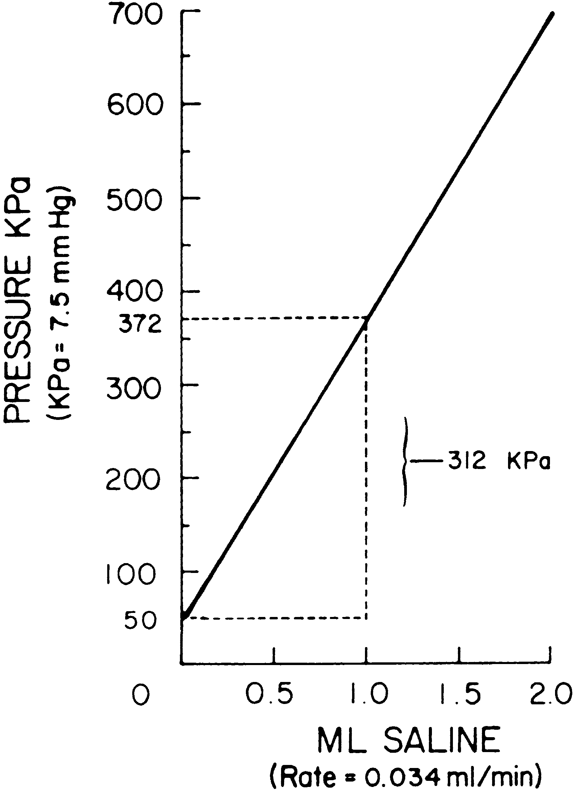
Relation schema of intra-disc pressure and injected saline volumes. Each ml of saline was injected, causing 312 Kpa internal pressure.

Slide 30
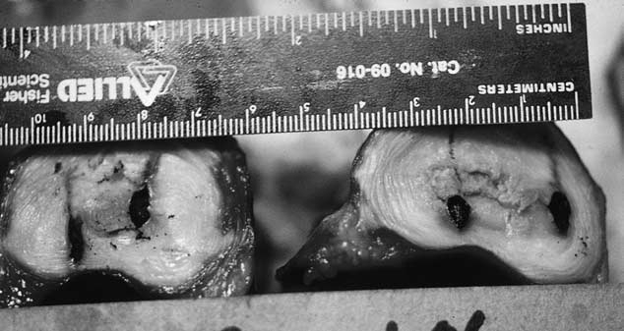
1000 Joule Laser Energy
Wound of 10mm x 5mm were created in the nucleus pulposus.

Slide 31
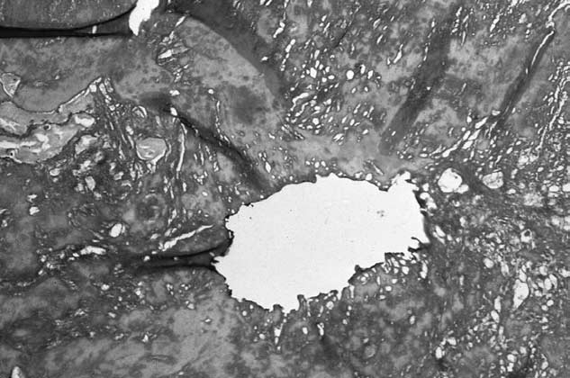
Laser beams appear in the tissue map of the nucleus pulposus.
The central pore is surrounded by denatured proteins and vacuoles, which may be a vapor sac.

Slide 32
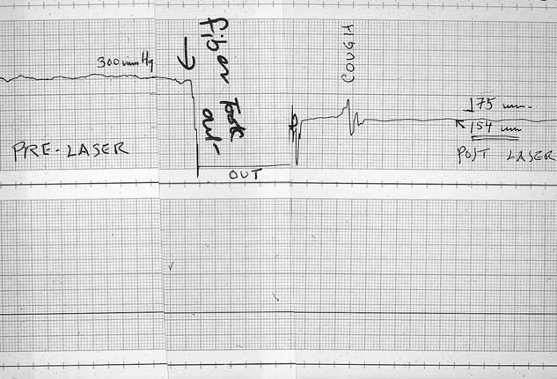
Intradisc pressure before / after PLDD surgery. Drop down from 300 mmHg to 154 mmHg. This is an open pressure, the "peak" is because the cough.

Slide 33
The First PLDD in Human History
Research was conducted at the Institute of Neurosurgery in University of Graz, Austria
Dr. Daniel S.J. Choy in collaboration with Dr. Peter Ascher
Date: mid-February, 1986

Slide 34
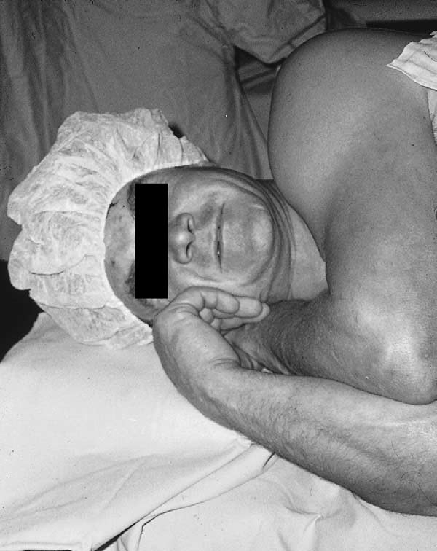
In February 1986 at Graz, Austria, the first patient to undergo percutaneous laser disc decompression (PLDD), 600 joules. The pain disappeared.

Slide 35
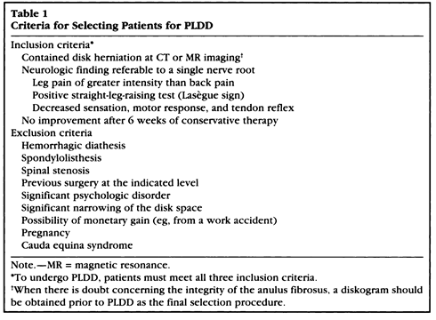
PLDD : Applicable Patients

Slide 37
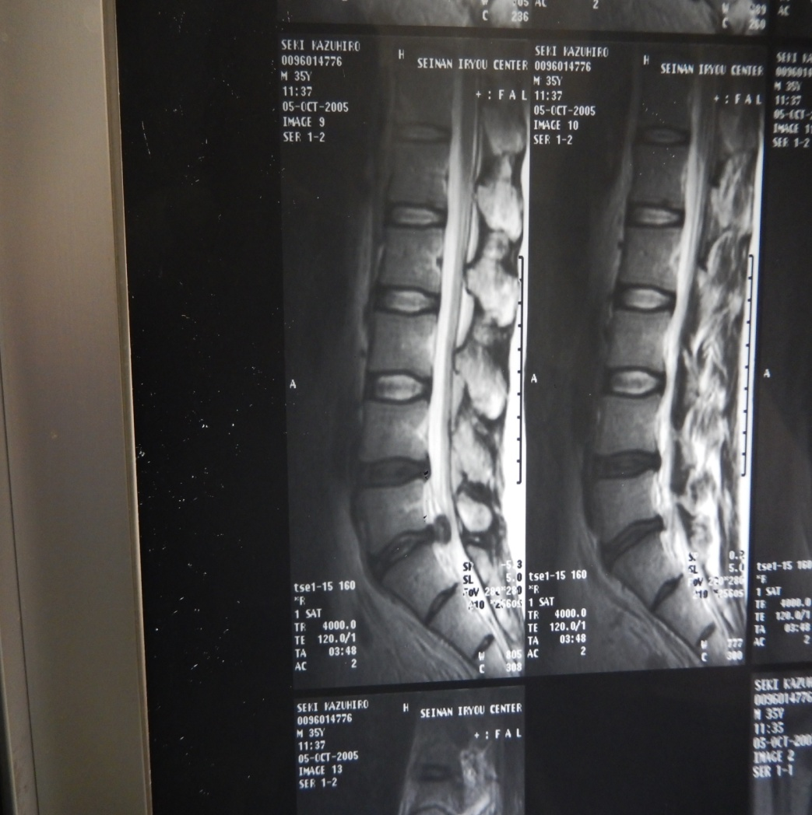
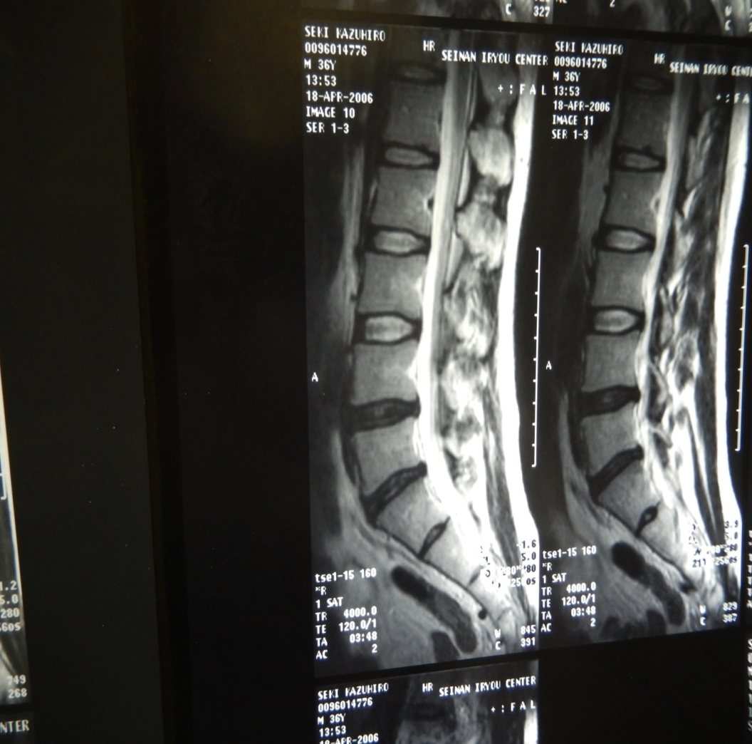
NMR-imaging Before and After PLDD
Patient A
PLDD before
Patient A
PLDD after

Slide 38
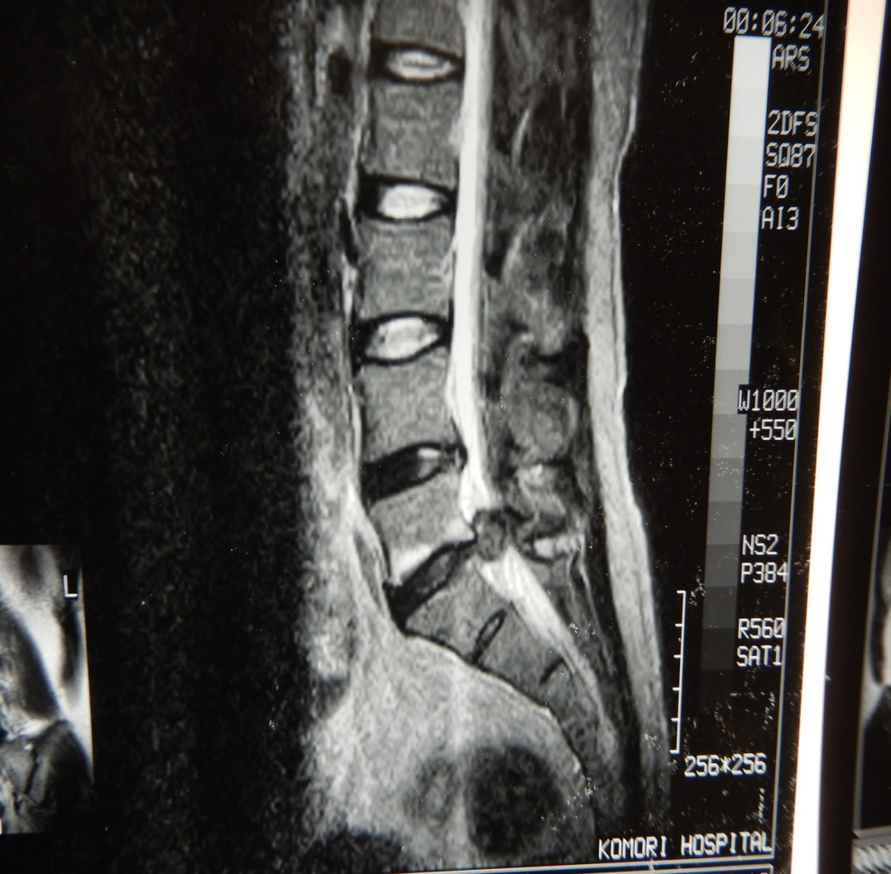
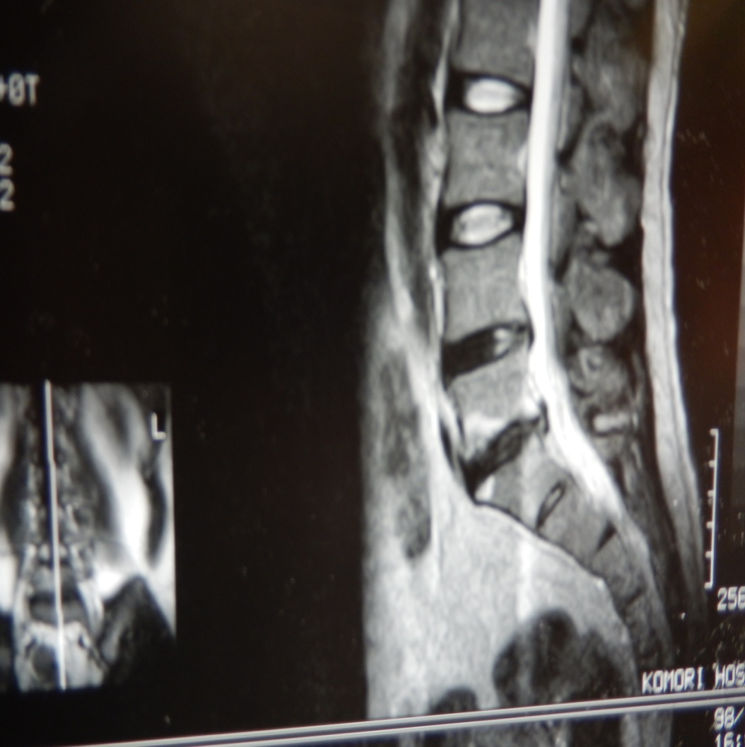
NMR-imaging Before and After PLDD
Patient B
PLDD before
Patient B
PLDD after

Slide 39
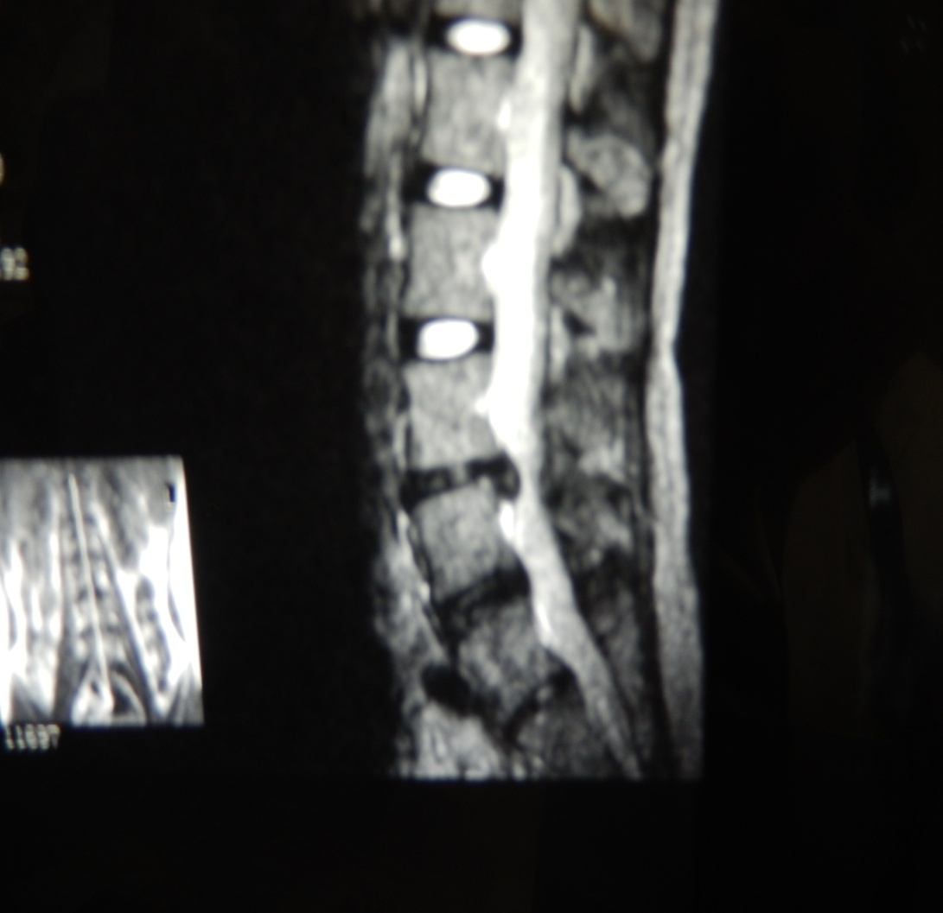
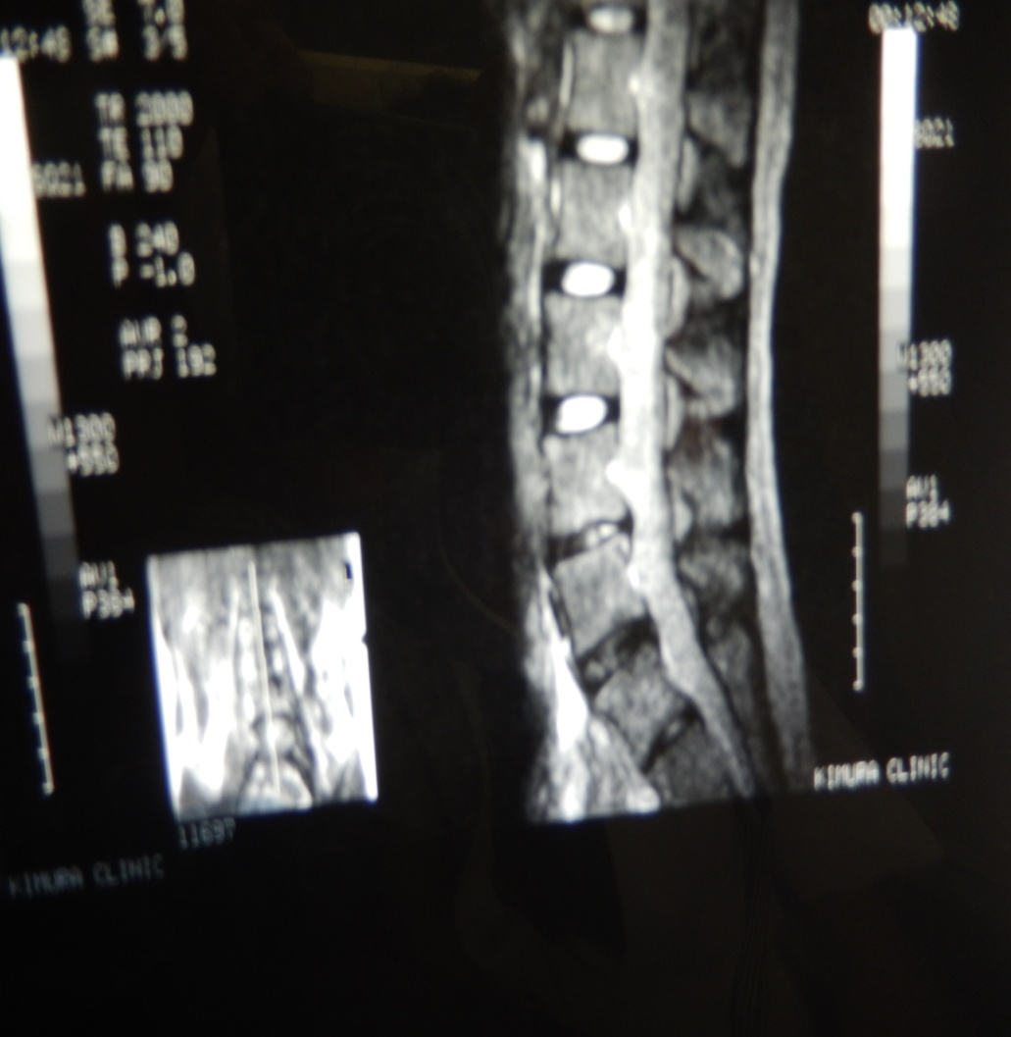
NMR-imaging Before and After PLDD
Patient C
PLDD before
Patient C
PLDD after

Slide 40
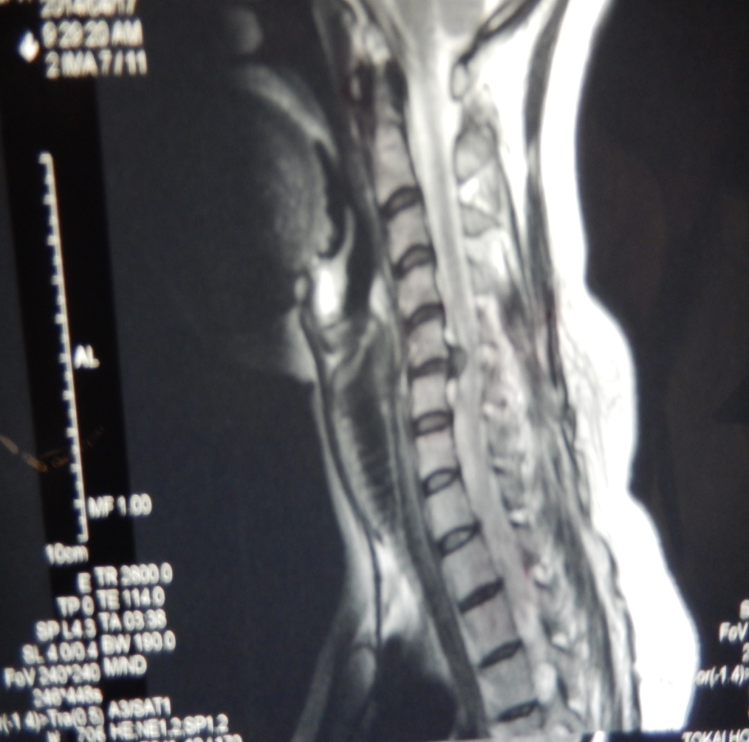
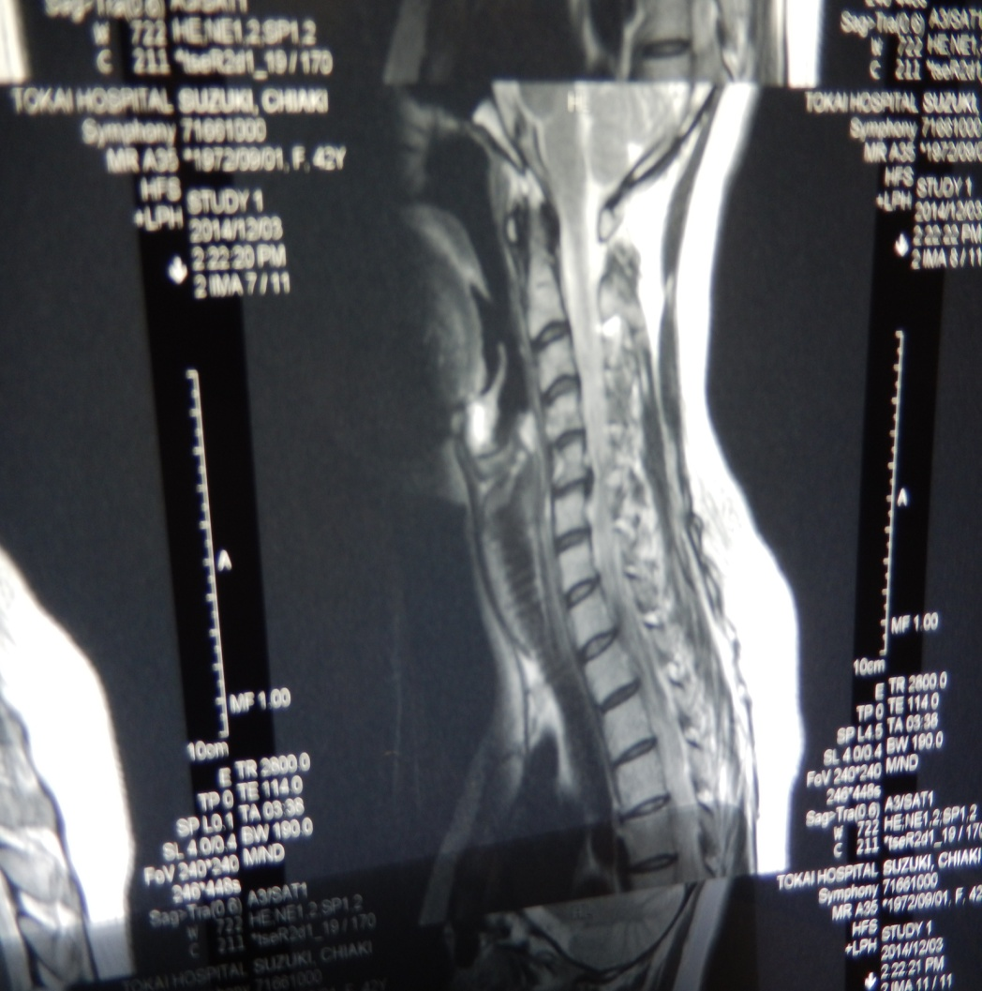
NMR-imaging Before and After PLDD
Patient D (cervical spine)
PLDD before
Patient D (cervical spine)
PLDD later

Slide 41
PLDD
Clinical Effectiveness

Slide 42
Effectiveness
Photomedicine and Laser Surgery Volume 27, Number 4, 2009
ª Mary Ann Liebert, Inc. Pp. 535–538
DOI: 10.1089=pho.2009.2512
Percutaneous laser disc decompression (PLDD) for 23 years
Daniel S.J. Choy, M.D.,1 Johannes Hellinger, M.D.,2 Stefan Hellinger, M.D.,2 Gian Paolo Tassi, M.D.,3 and Sang-Ho Lee, M.D.4

Slide 43
PLDD patients treated with a combination of Nd: YAG laser, diode laser, and Ho: YAG laser and endoscopy.
The success rate is 70-89%.
The complication rate, mainly the intervertebral discitis, was 0.3 – 1.0%.
The average time to return to normal activity was 1 week.
Twenty-three years of prolonged follow-up yielded a recurrence rate of only 4 – 5%.

Slide 44
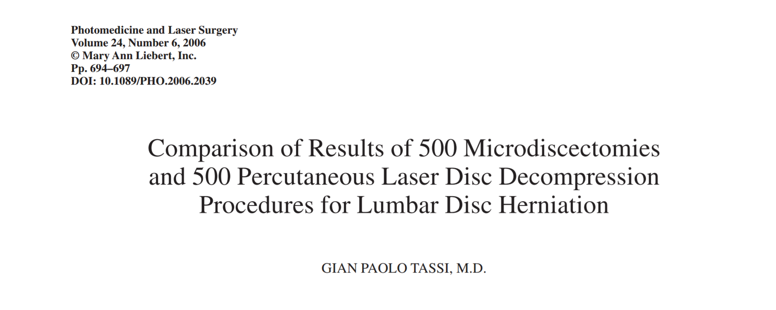
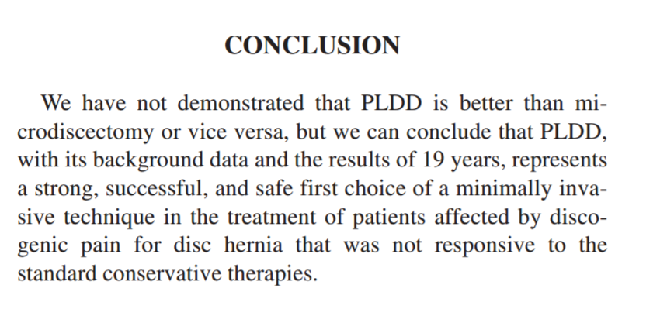
Compare the results of 500 minimally invasive discectomy and 500 percutaneous laser disc decompression
Summarize
Although we have not yet proved that PLDD is superior to minimally invasive discectomy, but we can conclude that PLDD is the primary choice for minimally invasive techniques cause of its success and safety, from the background of PLDD and 19 years of research results, and patients with herniated disc source pain and those who fail to respond to traditional drug therapy.

